Slide 1
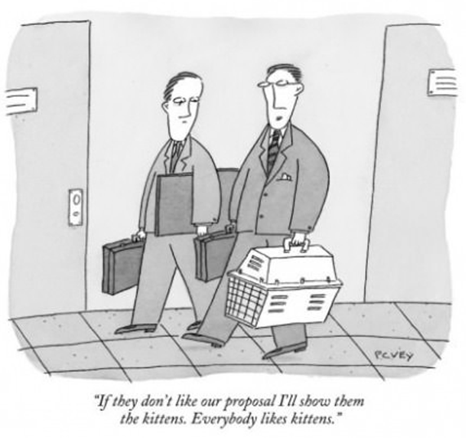
ARMageddon – Meeting # 5

Slide 2
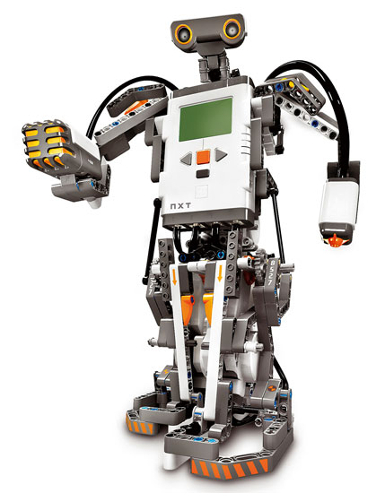
Gantt Chart
Some feedback from last week:
- testing should be on the Gantt chart (as mostly everything)
- resources (staff working on activity)
- start date, end date
- tests are there, for all java class and unit testing
- low level
- Gantt summary for this week:
- code done and tested by Friday
- last improvements and doublechecks by Sunday
- all documentation done by Friday
- doublechecks of documentation during week-end (compare with design ppt from class)
- poster, sketch done, we have the pieces, rough final copy should be done by Friday

Slide 3
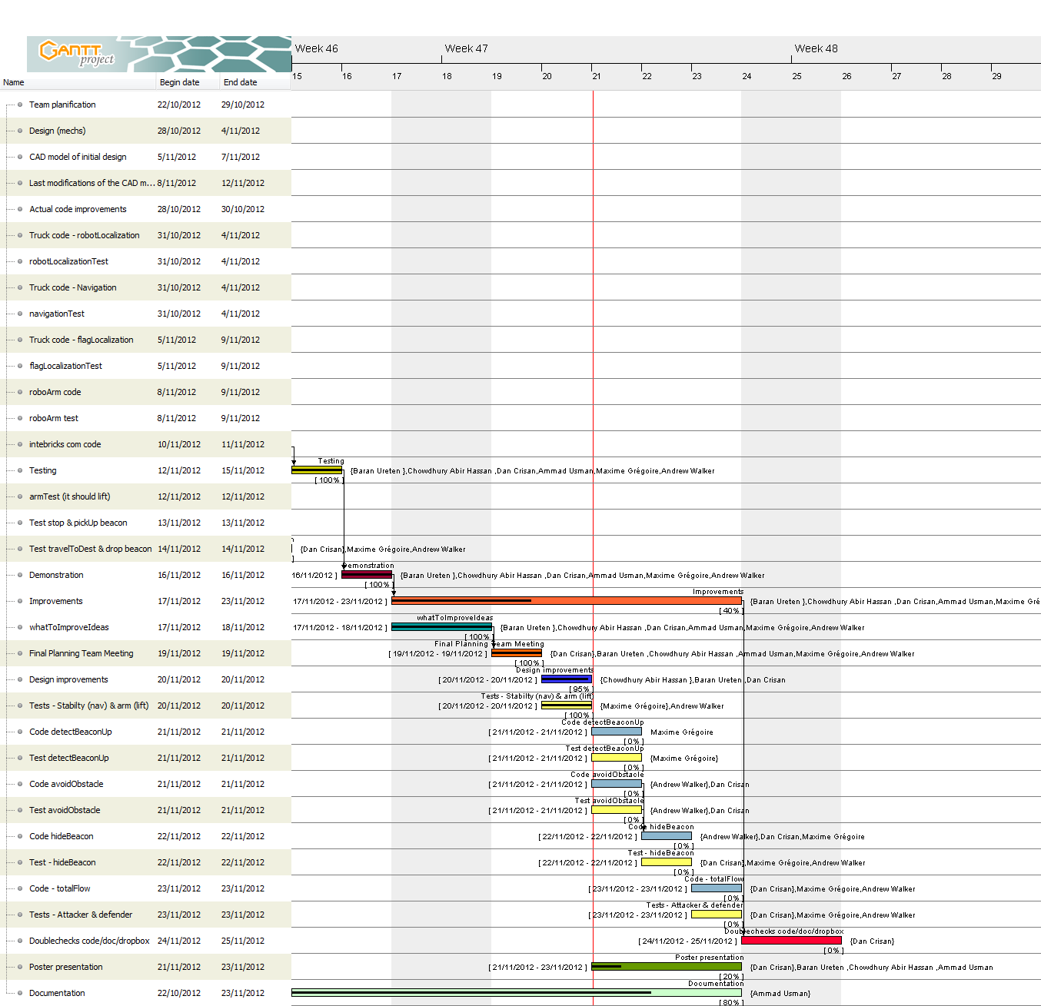

Slide 4
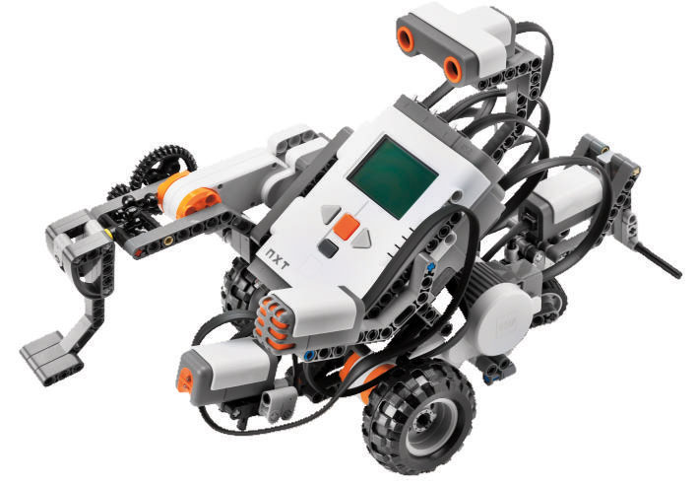
Weekly time budget
Names |  | Week 1 (estimation) | Week 2 | Week 3 | Week 4 | Week 5 | Total
Ammad Usman |  | 7 | 6 | 8 | 9 | 9 | 39
Baran Ureten |  | 7 | 7 | 9 | 12 | 9 | 44
Chowdhury Abir Hassan |  | 7 | 6.5 | 7 | 11 | 12 | 43.5
Andrew Walker |  | 7 | 5 | 6 | 11.75 | 15 | 44.75
Maxime Grégoire |  | 7 | 5 | 8 | 11.5 | 15 | 46.5
Dan Crisan |  | 7 | 6.5 | 9 | 11 | 13 | 46.5
 | Total/week (hours) | 42 | 36 | 47 | 66.25 | 73 | 264.25
Logs hyperlink
Charts about how the time has been spent in documentation
Feedback: were below budget
Average hours now: 45h ( 9 x 5)
Reorganized dropbox

Slide 5
Competition checklist
Batteries…
Last Friday “pray for the batteries now” = learn from our mistakes = WILL NOT HAPPEN AGAIN
Happened because unplanned issue due to stability on long distances (talk about it later)
Overtesting…
Batteries…
During testing and lab hours: charged batteries
During competition: brand new 12 batteries that we will try only once, the day before the compe… just in case.
Batteries…
Rope (a good 10m… worst case scenario: losing 1m per round, for 6 rounds?) – never happened… hence just in case.
Testing check-ups! (Sunday and day before competition) -> Next page
Bluetooth on and visible? Just in case…
Is the code uploaded? Just in case…
Is the good code final version uploaded? Just in case …
Does both bricks have new batteries?
Are we using the good bricks? (MFalcon & SEagle)
Ports
Last version

Slide 6
Current status of testing and test documentation
What we have:
Code about testing arm grab and lift: works
Code and data about testing light localization: works
Code about testing beacon search: works
Code about receiving bluetooth coord and navigate towards it : works
Filming everything (videos to be uploaded on youtube, soon.) : just in case nothing works during the compe since different environmental conditions, we can show that it works.
Problem: code about testing navigation: works on short distances (5 tiles?) BUT!

Slide 7
Current status of testing and test documentation
Problem: code about testing navigation -> works on short distances (5 tiles?), but not on long distances (10 tiles); This is due to lack of stability and wheels material (they have a tendency to fold weirdly…) -> can be seen on videos and on measured data
Improvement: improve stability (improve symmetry of the robot, design)
Improvement: use Play-doh to strengthen the wheels
Wasn’t a major problem for the demo since short distances to travel (field max 7 tiles and beacon placed arbitrary) but could be potentially devastating for the competition: tried to fixed it before the demo -> overused batteries by testing;
Wasn’t a concern for the demo final rezult: didn’t got full marks because of a coding mistake -> coded for only “turn toward coord” and forgot to call method “goTo coord”… Moral of the demo?
Always double-check the final code that we upload.

Slide 8
Plans for competition week
What we will have:
Avoid obstacle testing class
Beacon detection @ multiple levels testing class
Hide beacon @ specific coord testing class & data
Hide beacon @ specific coord + obstacles testing class & data
Videos for all unit test that we do
Video for final result just in case it’s not working on different environment.
Comments and Javadocs on each class

Slide 9

Questions
Budget for the first week is an estimation?
Any budget for 6th week?
Should we worry about when the obstacle is at the max top?
What to improve? (weakest part?)
Other…

